Slide 1
Prediction for time series with missing values
MAP573 Group 9
Victor Bossard Aubry d’Andoque
Liwenhan Xie Yelan Mo

Slide 2
Objective of the Project: Best Forecast
Different methods for the forecast
What is a good forecast ?
Need to define a metric and apply it on each method to compare every results we get
Suggestions : Mean Absolute Error, Mean Square Error, residual forecast error and forecast bias
Notes:
We’ve studied the time seires therem and applied the simple methods and compare them. At last we found that it seems the simple methods works very well.

Slide 3
Plan of the Presentation
Global Analysis
The Simple Methods
Vector Autoregression (VAR)
Neural Network Time Series Forecasts (NNAR)
Autoregressive Integrated Moving Average model (ARIMA)
Seasonal Decomposition
Results & Conclusion

Slide 4
Overview
Data Description
Visualization

Slide 5
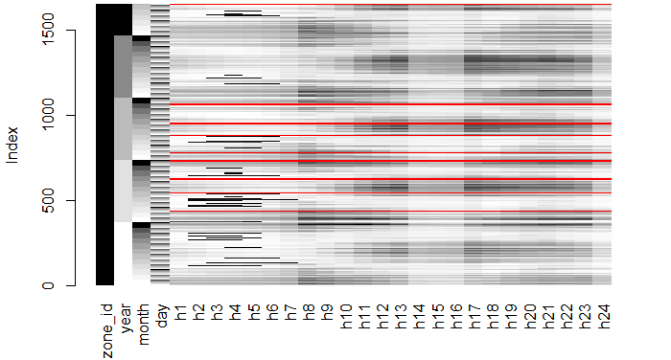
Data Description
Hourly energy loads (in kW) for a US utility with 20 zones. Zone 21 is the total.
Hourly temperature (in ℉) for 11 stations
Missing Period
2005/03/06 0am - 2005/03/12 11pm;
2005/06/20 0am - 2005/06/26 11pm;
2005/09/10 0am - 2005/09/16 11pm;
2005/12/25 0am - 2005/12/31 11pm;
2006/02/13 0am - 2006/02/19 11pm;
2006/05/25 0am - 2006/05/31 11pm;
2006/08/02 0am - 2006/08/08 11pm;
2006/11/22 0am - 2006/11/28 11pm;
Prediction Period
2008/06/30 5am - 2008/07/07 11pm

Slide 6
Preliminary Concepts
Patterns in time series
trend + seasonal + cyclic
Stationarity: statistical properties are all constant over time
Basis of many traditional model.
Use high-order difference to achieve stationarity.
Correlation: Cov(X,Y) = E(X-EX)(Y-EY)
Auto correaltion: correlation between points separated by n time periods
Partial autocorrelation: auto correlation with the control of other variables
help to identify AR model

Slide 7
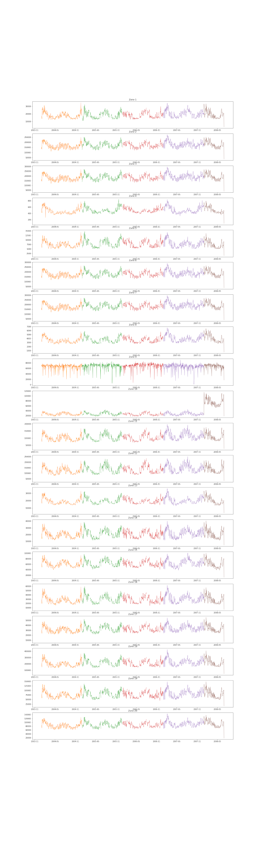
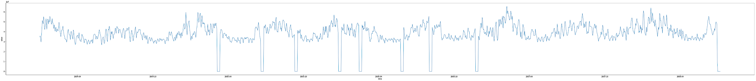
Visualization of Raw Data
1
2
3
4
5
6
7
8
11
12
13
14
15
16
17
18
19
20
All
The relative trends are somehow similar;
Zone 9 is noisy and highly unstable.
Zone 10 has an abrupt increase in the last year.

Slide 8
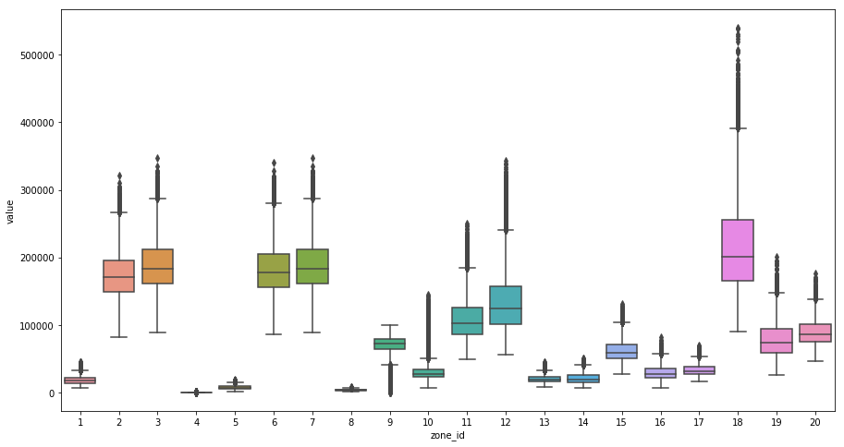
Raw Data
The data distribution of different zones are quite distinct.

Slide 9
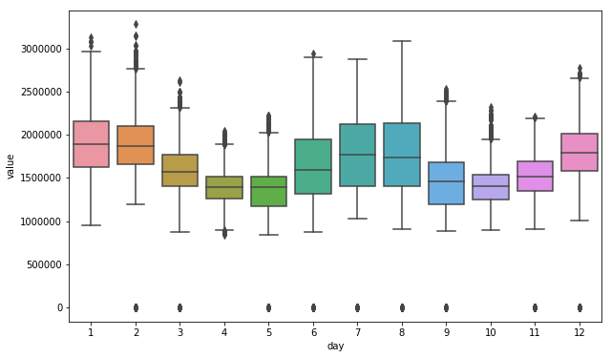
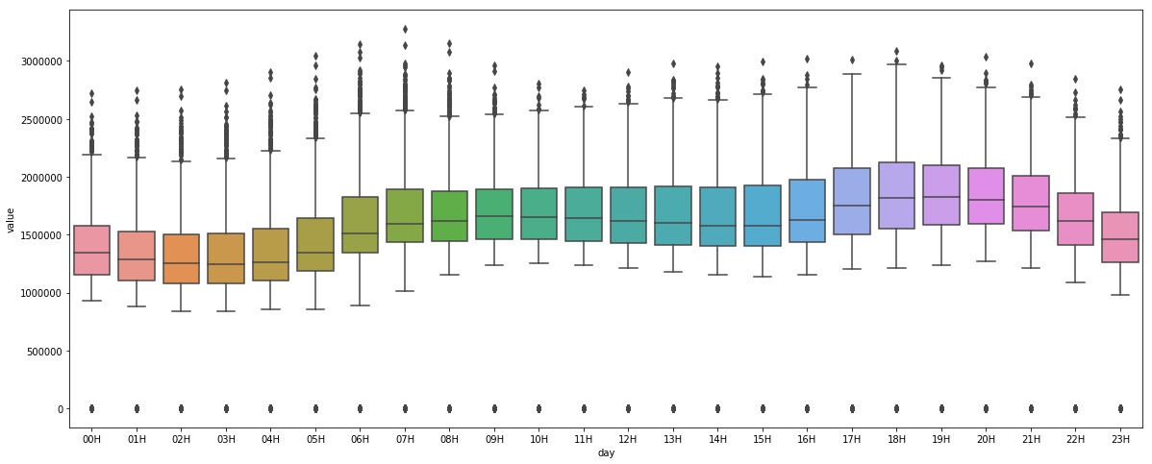
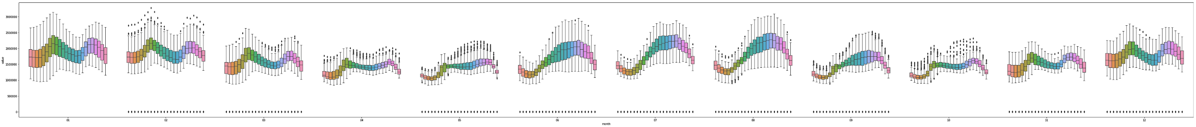
Visualization of the Overall Pattern in Zone 21
Strong seasonality in season, month, and hour
12 Month
24 Hour
The Energy Loads Hourly Distribution of Each Month

Slide 10
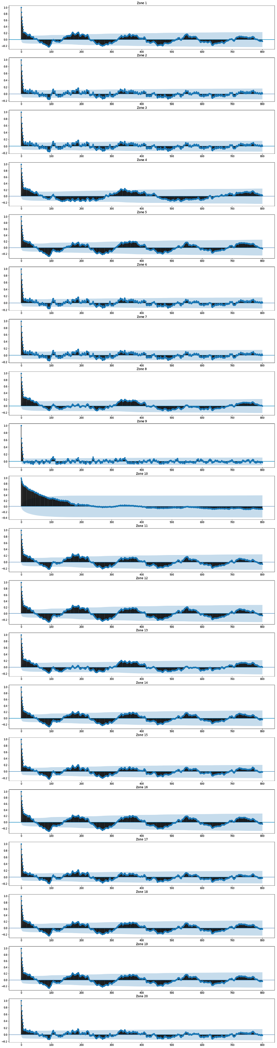
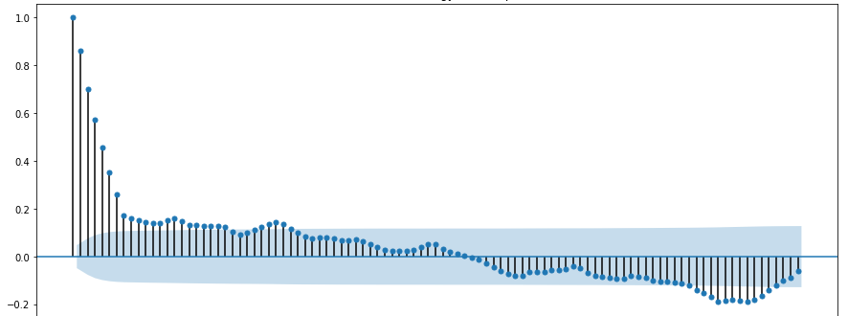
Daily ACF result
0
800
0
800
The annually, monthly, or weekly correlation is not significant.
Exception zone: 9, 10
Global ACF
0
100

Slide 11
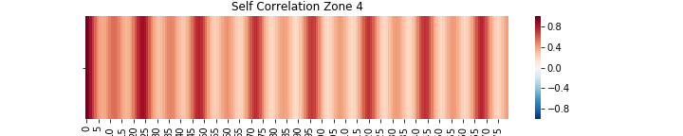
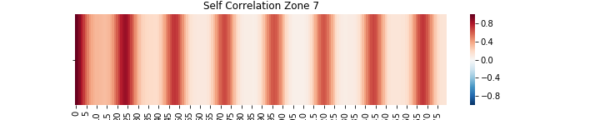
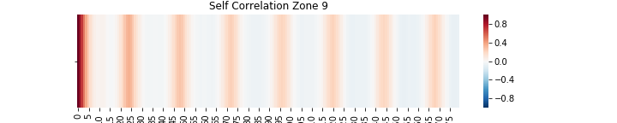
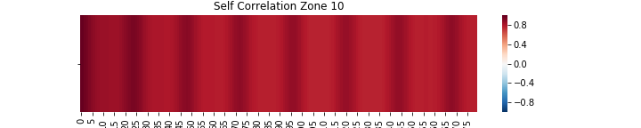
Hourly ACF result
24h
1 week
Zone 4
In most areas, 24 hour contributes to the highest correlation.
In zone 9, 12 hour contributes to the highest negative correlation, while the 24 hour lag is not as clear as other zones.
In zone 10, close timestamps are always highly correlated.
Zone 7
Zone 9
Zone 10

Slide 12
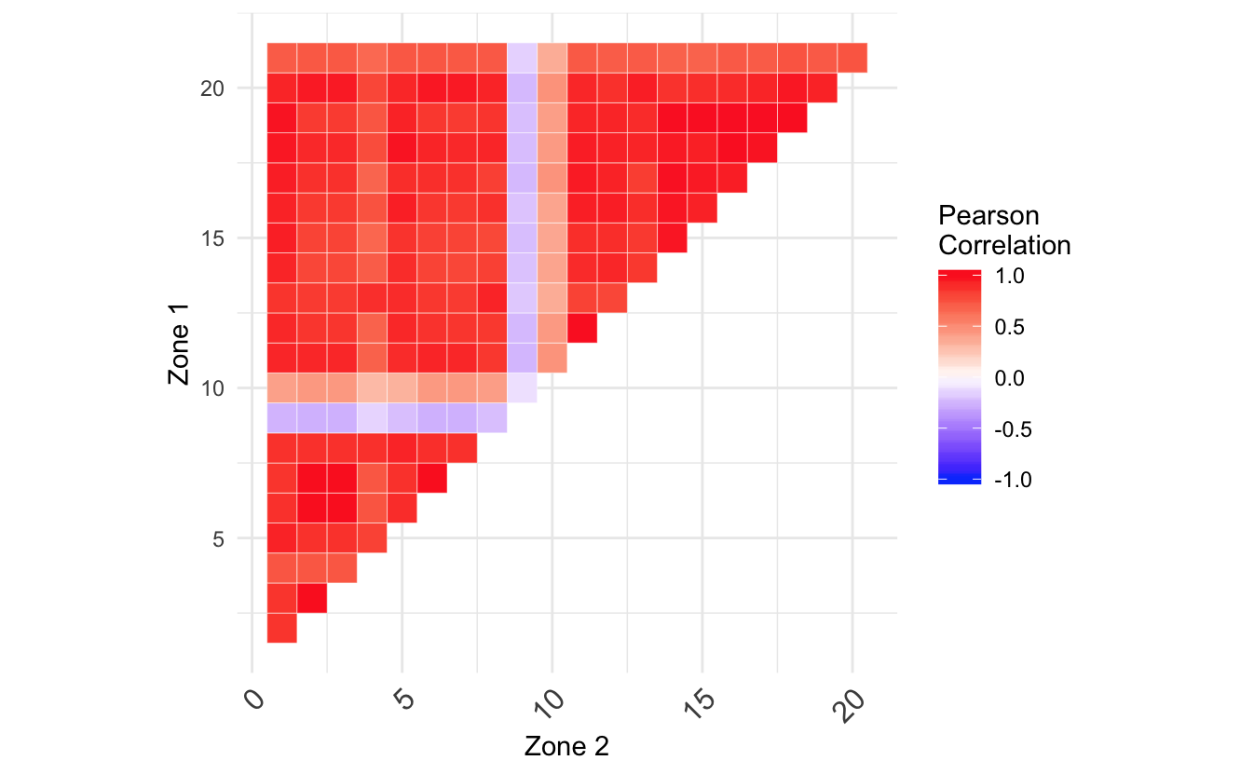
Cross-correlation of zones
Zones 9 and 10 appears to be resp. anti-correlated (-0.25) and less correlated (0.4).
No explanation in the challenge abstract.

Slide 13
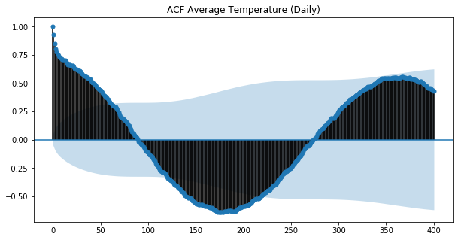
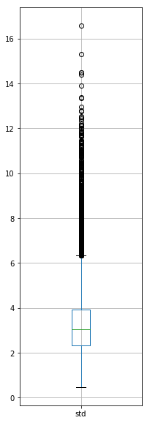
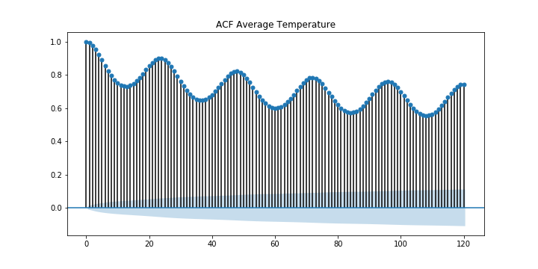
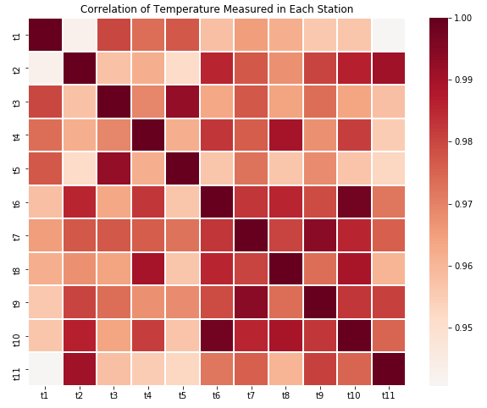
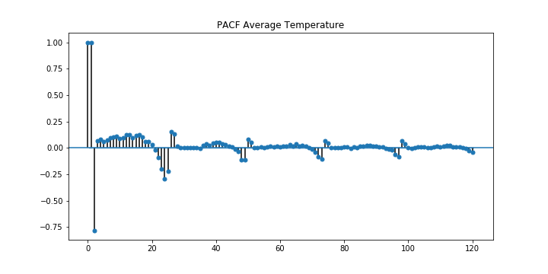
Temperature
SDT
400-day ACF
Highly correlated (> .94)
Strong autocorrelation
5-day ACF
5-day PACF

Slide 14
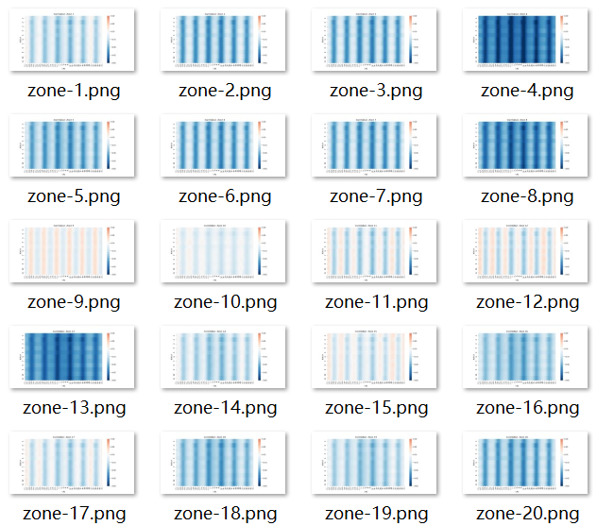
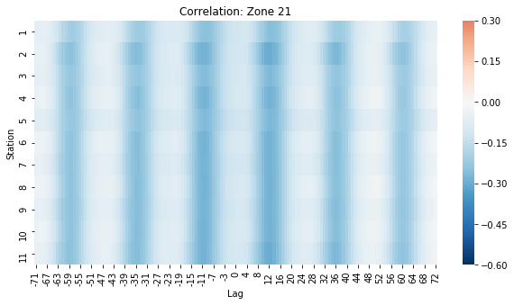
Correlation with Temperature
the highest correlation happens at the 12h lag
a negative correlation

Slide 15
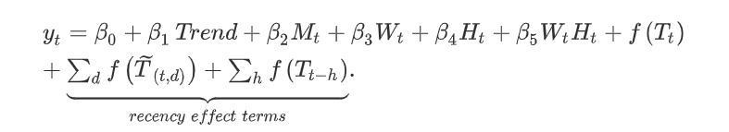
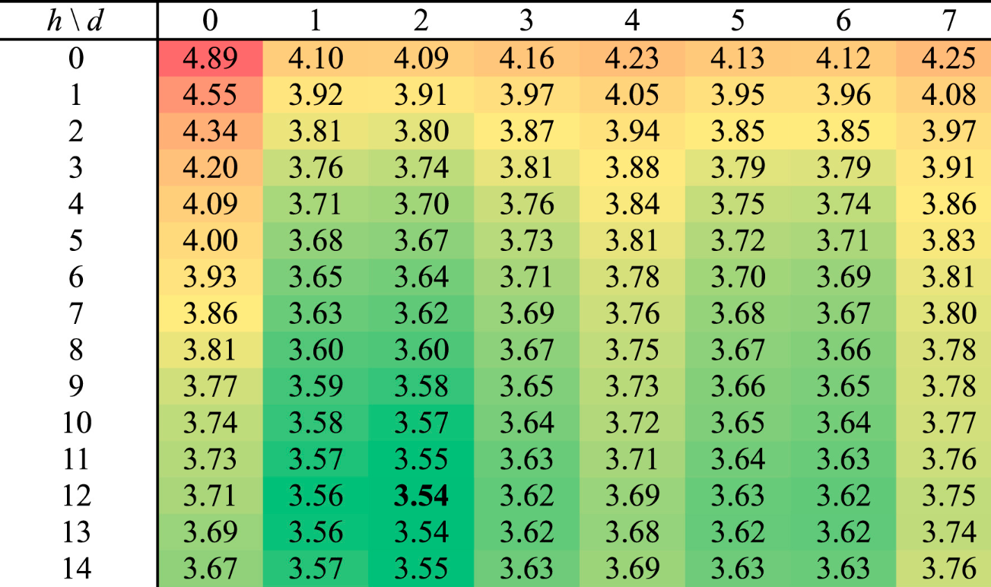
Explanation
Data pattern
in accordance with the original paper
[Wang et. al., 2010]

Slide 16
Methods
Introduction
Simple Methods
VAR
NNAR
Seasonal Decomposition
ARIMA

Slide 17
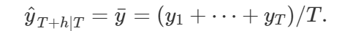
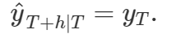
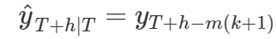
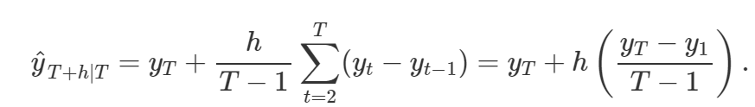
Classic Methods in Time Series Analysis
Average
Last Observation / Seasonal Naive
Drift

Slide 18
Forecast Accuracy Metrics
Metrics | Formula | Explanation/Analysis
Mean Error | mean(errors) | Scale dependant
Root Mean Square Error | sqrt(mean(e^2)) | Big errors are more penalized
Mean Absolute Error | mean(|errors|) | All errors big or small have the same impact
Mean Percentage Error | mean(100*e/y)
Mean Absolute Percentage Error | mean(100*|e|/y) | tells how much % predictions differ from true values, do not depend on the data set
Mean Absolute Scaled Error | mean(|q|) | Used to compare forecast methods over series with different units
ACF1 | Autocorrelation of errors at lag 1 | Relates to the randomness of the error

Slide 19
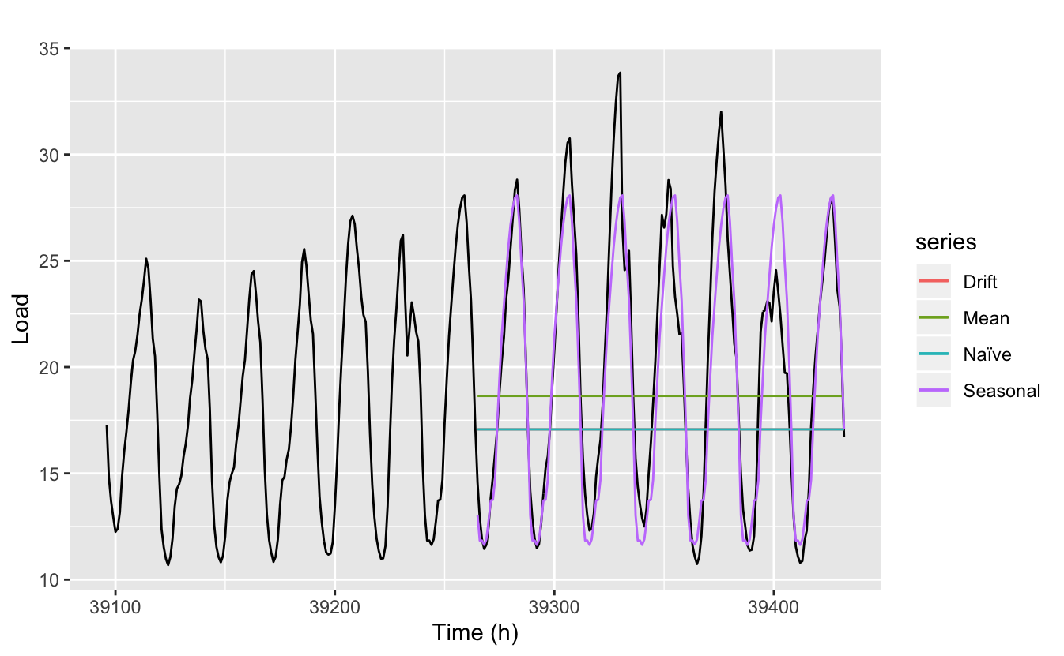
Simple Models Results

Slide 20
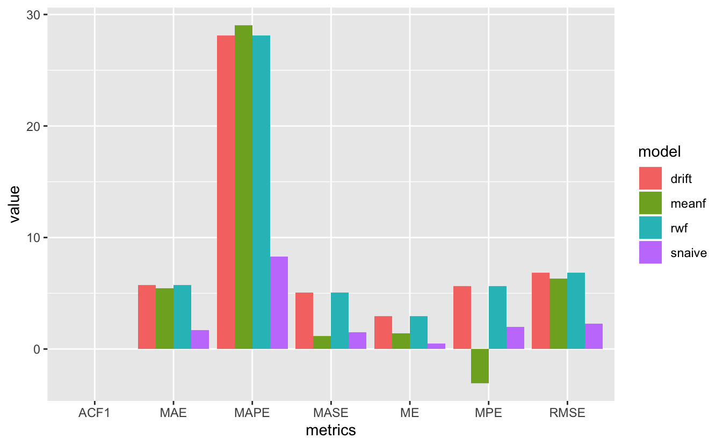
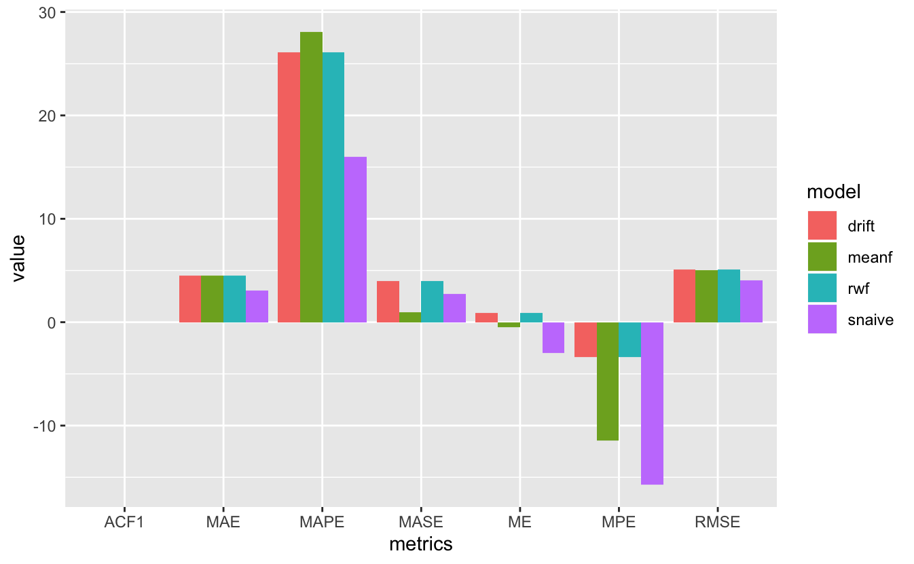
Associated Metrics
Seasonal Naive method give the best results overall even though values highly depends on the forecasted period

Slide 21
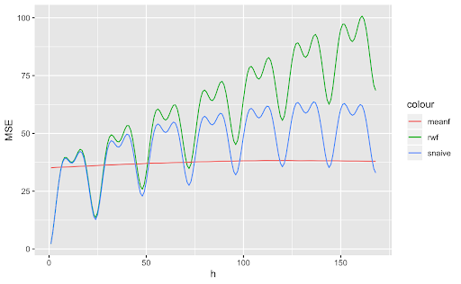
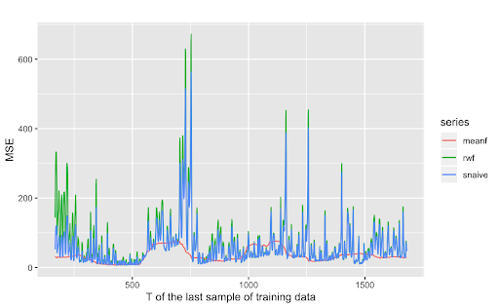
Cross-Validation : Effect of Forecasting Debut and Horizon

Slide 22
Vector Autoregression
Idea: to leverage the temperature information for a better prediction
VAR Basis:
Each of the time series in the system influences each other.
Granger’s Causality Test: checked
The time series to be forecast is stationary.
Augmented Dickey-Fuller Test: checked

Slide 23
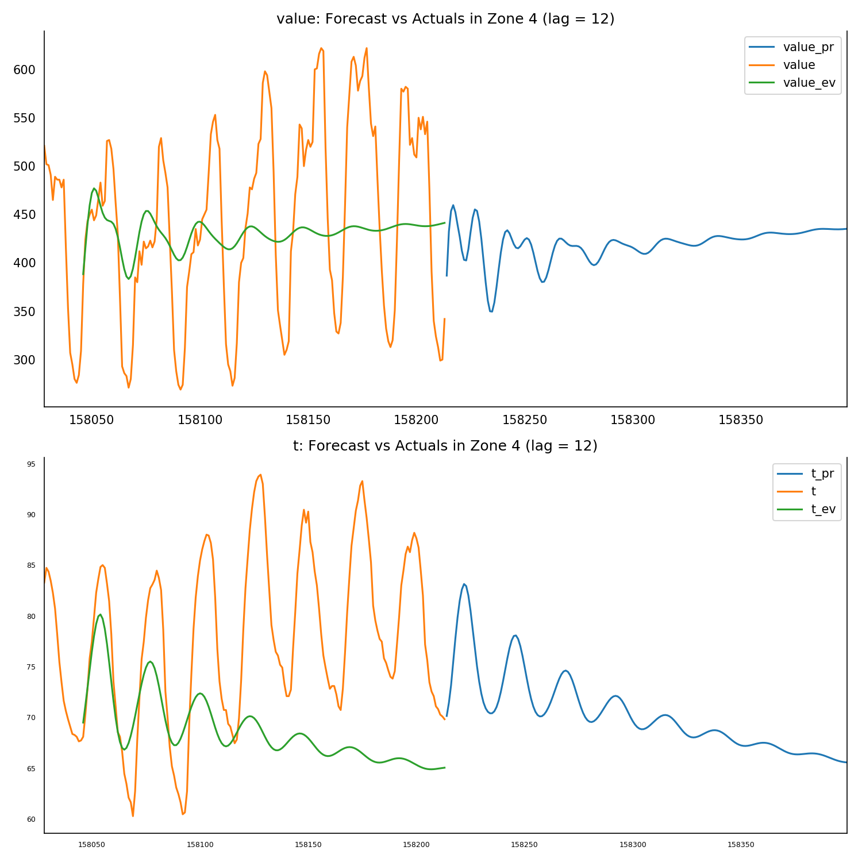
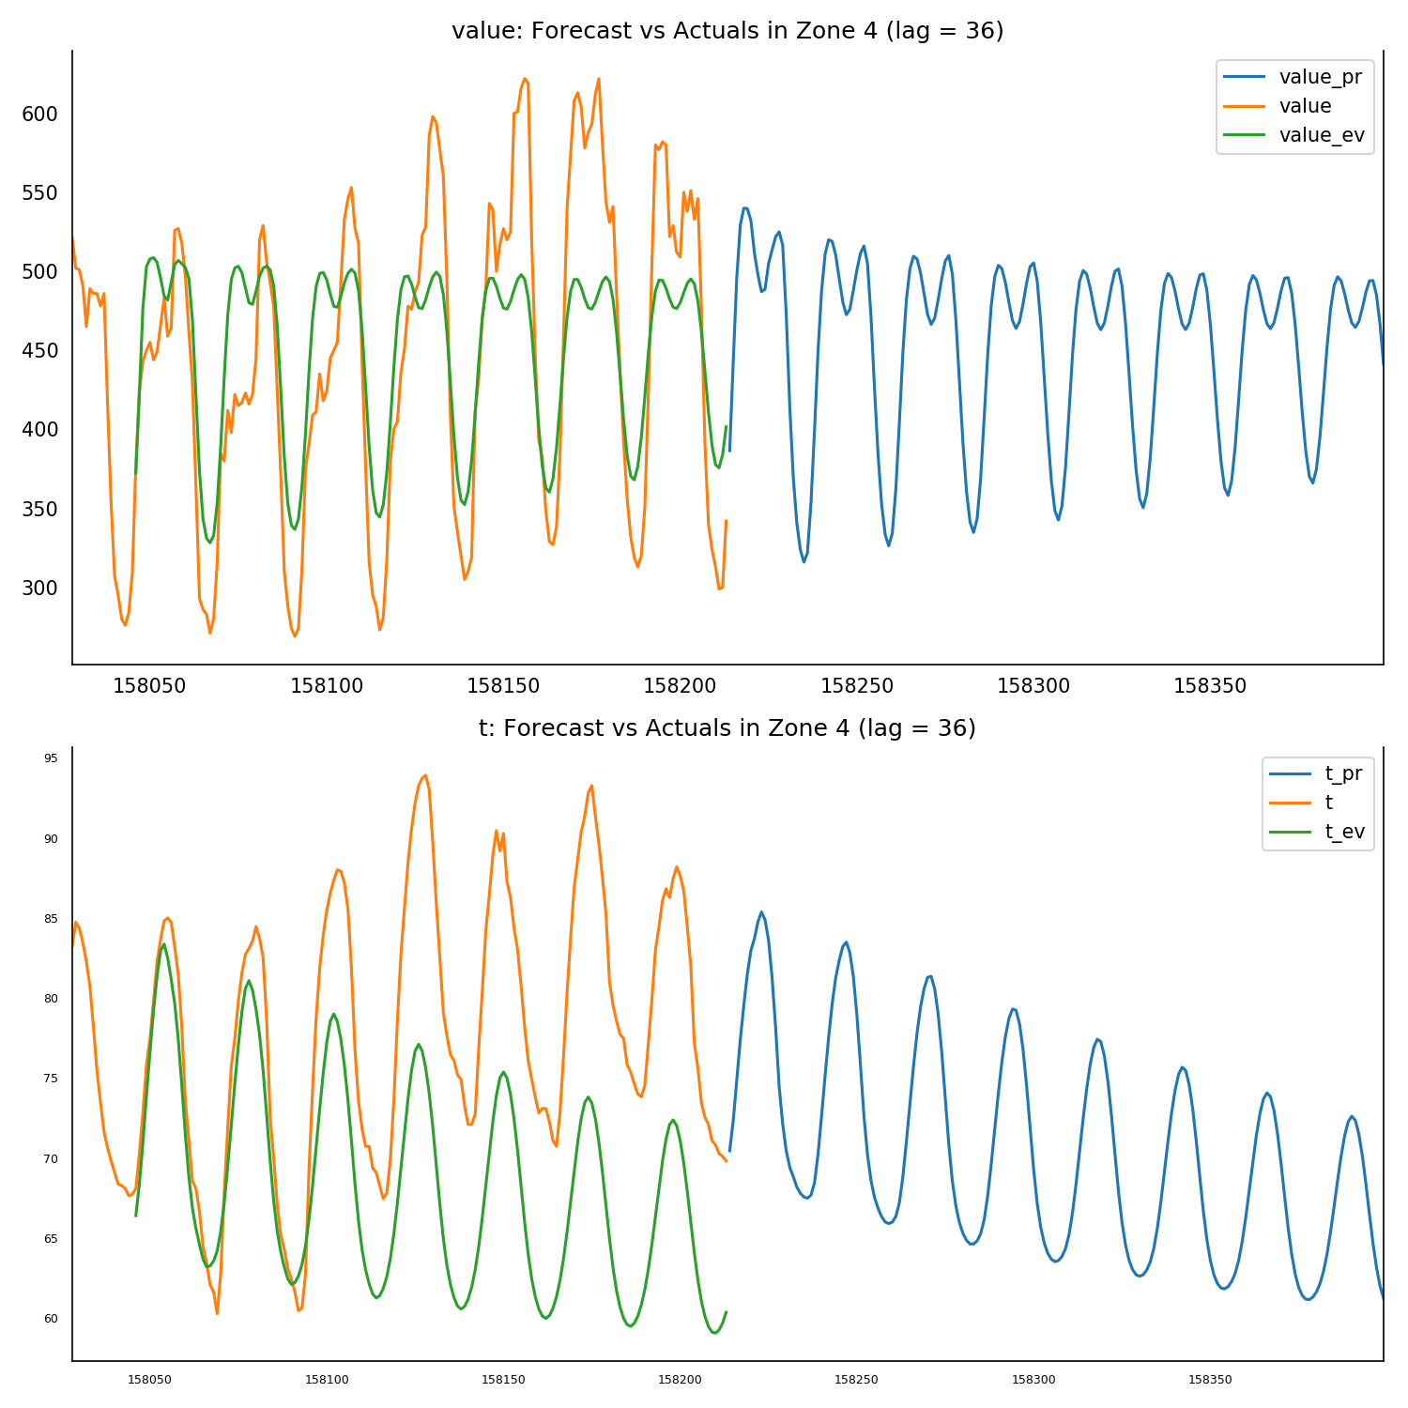
VAR Test
Filling method does not matter.
Fill the missing value with previous time slot
Fill with zero.
Lag is important.
AIC/BIC

Slide 24
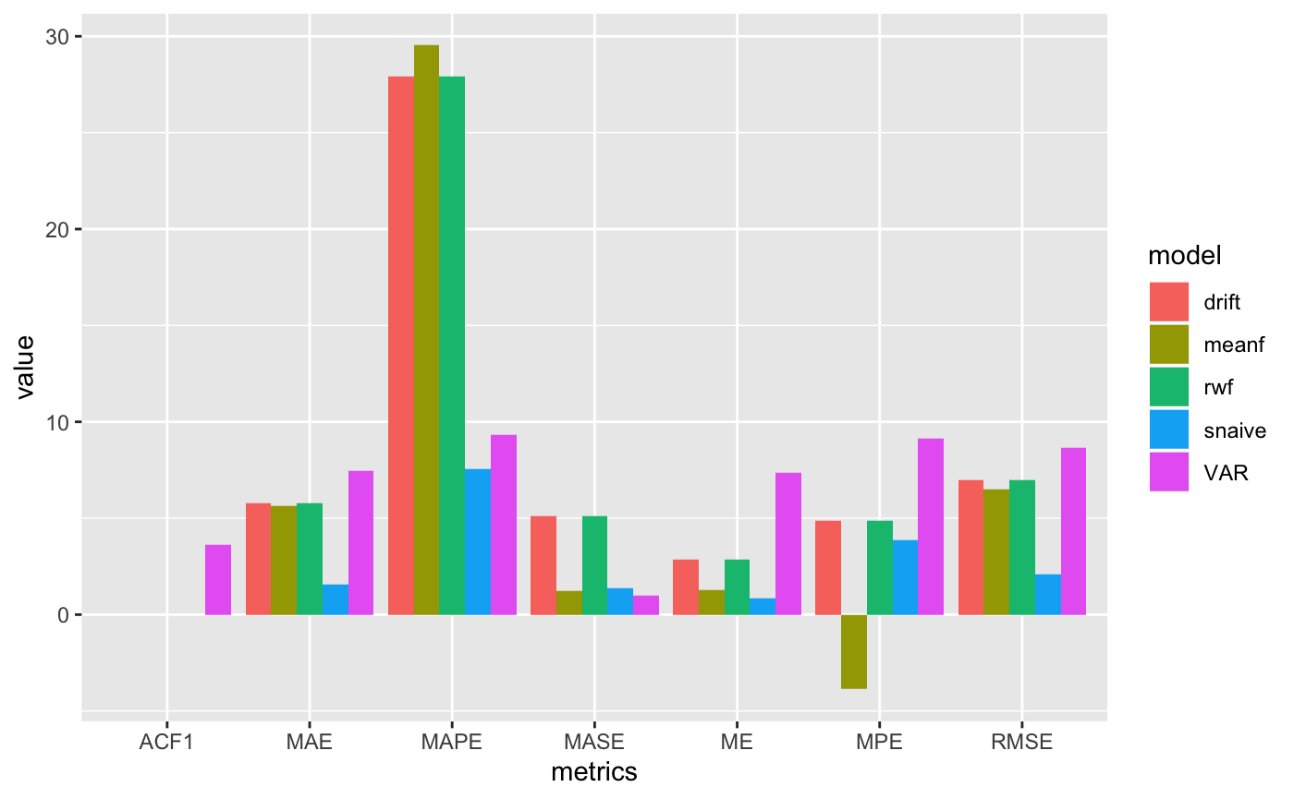
Result

Slide 25
Advanced Methods in Time Series Analysis
Neural Network Time Series Forecasts (NNAR)
Autoregressive Integrated Moving Average model (ARIMA)
Seasonal and Trend decomposition using Loess Forecasting (STLF)

Slide 26
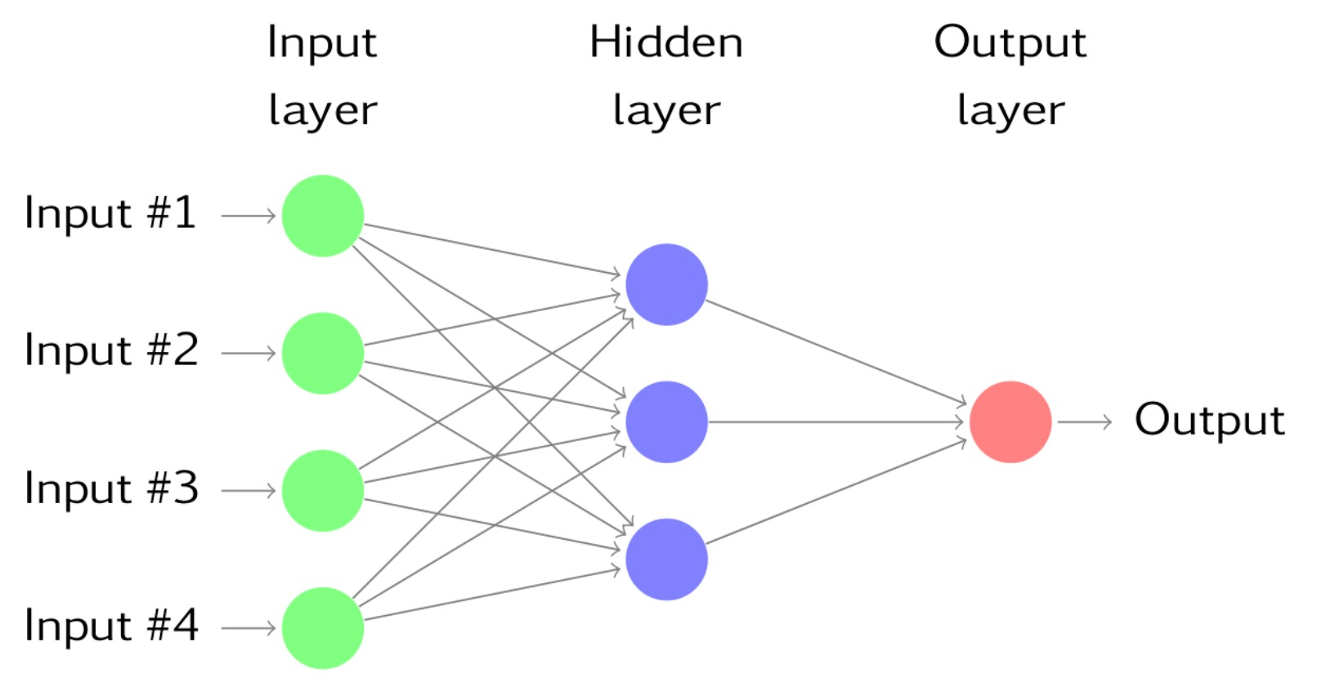
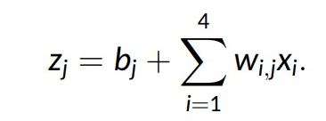
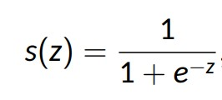
Neural Network Time Series Forecasts

Slide 27
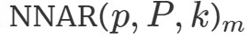
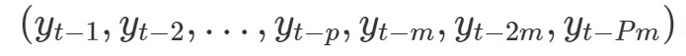
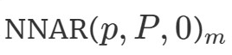
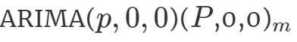
Neural Network Autoregression model (NNAR)
NNAR(p,P,k)m :
p : Number of non-seasonal lags used as inputs
P : Number of seasonal lags used as inputs
k : Number of neurons in the hidden layer
m : Number of observations per period
Input :
is equivalent to without seasonarity restrictions

Slide 28
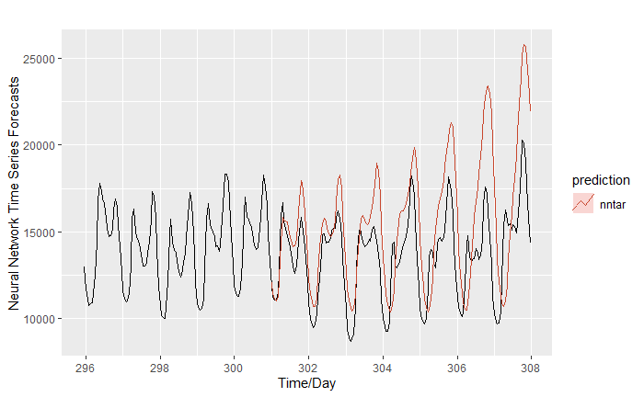
Neural Network Autoregression model (NNAR)
It is capable to capture the seasonality and the features

Slide 29
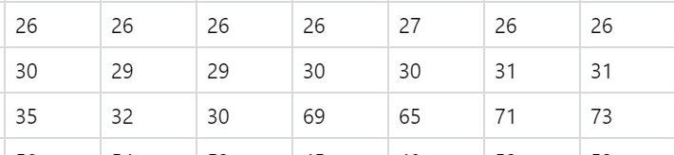
NNAR with External Regressors : Temperature
External regressor : the temperature
11 temperature stations : no correlation with the zones
How to correlate the stations to the zones ?
Matching the stations with zones is ”Businesswise wrong” cause “the data from a weather station in California may match very well with a zone in Florida. But, it is just a coincidence”
Dirty data : man-made hot source
=> Mean value of all the stations

Slide 30
NNAR with External Regressors : Temperature
Observation from the plot : x[t₋₁₂] more correlated than x[t₀]
According to the Ariticle [Wang et. al., 2010]
We chose the average temperature of the past 48 hours and the temperature 12 hour ago as the feature of the temperatures

Slide 31
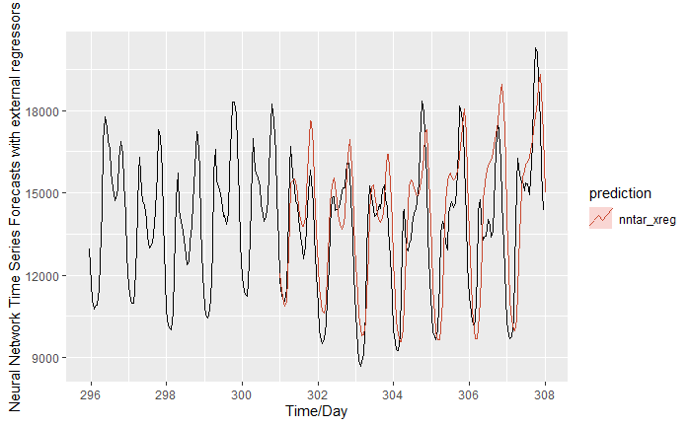
NNAR with External Regressors : Temperature

Slide 32
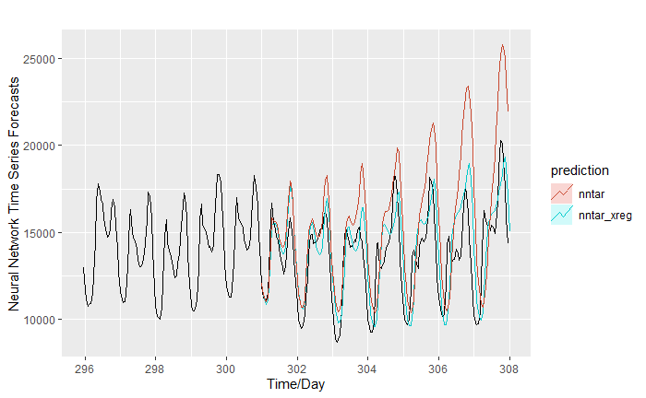
NNAR with / without External Regressors

Slide 33
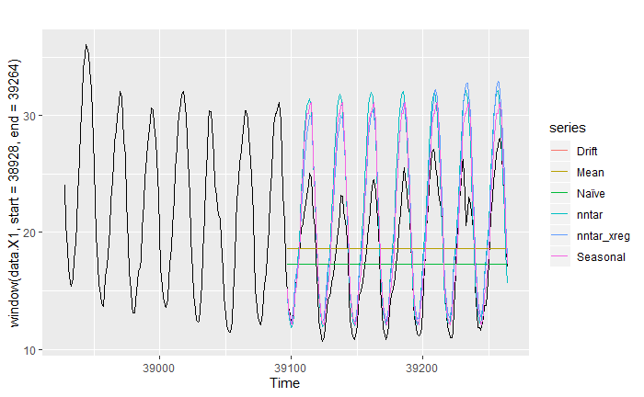
Comparison of the Measures

Slide 34
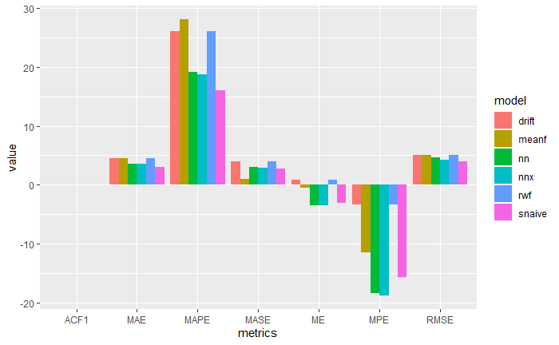
Comparison of the Mesures

Slide 35
Advanced but classic methods
Focus firstly about load in zone 21 (sum) UNIVARIATE prediction:
-It is the most important part in the evaluation of performance
-It is easier to forecast and interpret (no interactions between zones)
Methods tried :
-ARIMA (automatic detection)
-Seasonal and Trend decomposition using Loess Forecasting model
-ARIMA with external regressor (Fourier terms and temperature)

Slide 36
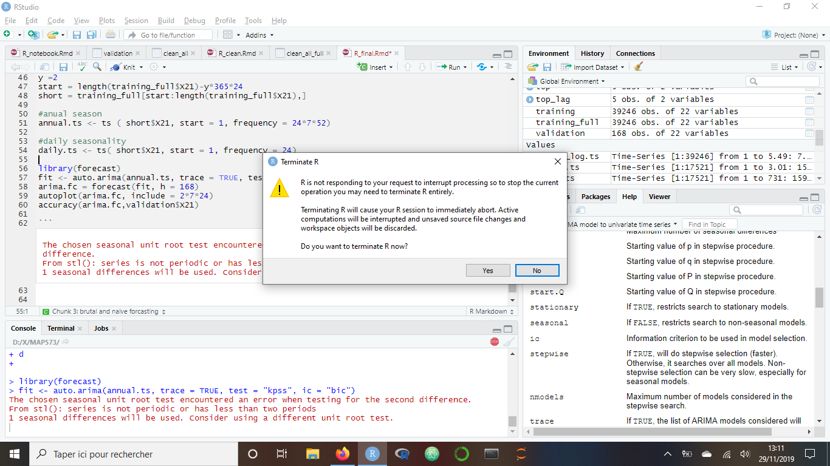
Step 0: a brutal (and naive) forecast with ARIMA
What happened ?
Data collected every hour, time series of seasonality = 24*365 = 8760 !!
whereas auto.ARIMA struggles to fit model with seasonality > 300...

Slide 37
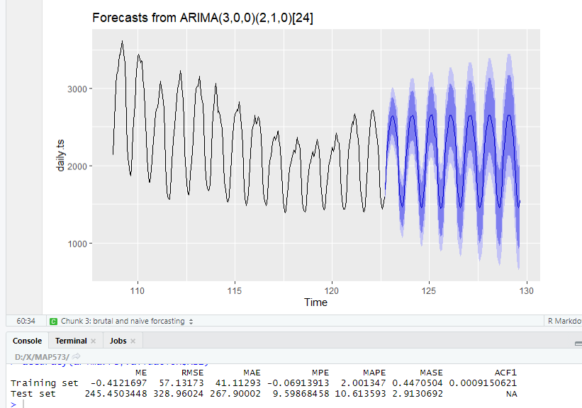
Step 0: a brutal forecast with ARIMA
Model trained over 3 months only
The model doesn’t capture bigger trends than the daily one :(
=> bigger training set !
Notes:
Model chose for non seasonal part:
-order autoregressive part = 3
-no differencing
-no moving average
Model chose for the seasonal part:
-order seasonal autoregressive = 2
-1 seasonal difference
-no seasonal moving average

Slide 38

Step 0: a brutal forecast with ARIMA
Model trained over a year
Now capture a moving average :)
But results are not as good as I hoped
ARIMA takes a while before fitting big dataset + 24 seasonality fixed
=> Other methods

Slide 39


Step 1: analyze seasonalities
Strongest seasonality : 182,25 days (half a year), a day (half the power), half a day (sixth the power)
ACF : peaks et lag of 24 and around 4400 => similar hint.

Slide 40


Step 1: MSTL Decomposition

Slide 41



Step 2: STLF Forecasting

Slide 42


But….

Slide 43
STLF Results
Highly dependant from frequency parametre in ts objects !
Only handle a unique frequency + (ETS/ARIMA… on the non seasonal data)
Can give quick and actually interesting forecasting !
=> Back to ARIMA with multi seasonal approach ?

Slide 44


Step 3: ARIMA with Fourier Regressors
ARIMA on ts with xreg 5 degrees in Fourier terms
ARIMA on msts with xreg 3 degrees in Fourier terms
!! Beware of computation time !!

Slide 45

Step 5: ARIMA with Temperature Regressor
Results from ARIMA with external regressor = auto.arima forecast on temperature
ARIMA forecast with xreg = forecast from temperatures ?
Same issue, equally hard to forecast

Slide 46
Result & Conclusion
Result
Conclusion
Future work

Slide 47
Conclusion
The Data : Even though we lacked some information (zones, MV, temperature..) this DS allowed us to explore differents techniques of data analysis
The Library : Mostly used forecast has it has implementation of all the methods, a good doc and a great community
The Models : After all, models greatly vary in complexity and the results are not get better with it.

Slide 48
Future Work
Cross Validation
RNN & LSTM
Other methods : BenchMark, Matrix Factorization for Multivariate Time Series Analysis, etc..

Slide 49
Thank you!😁

Slide 50
Q&A

Slide 51



Step 1: what about forecasting with previous week values?
Mmmmmm… not sure, might be risky
=>volatility of the data ?

